Slide 1
Semester Two - Week 2:
Designing the Data Collection Methods for Qualitative and Quantitative Research
Notes:
Delete this slide when you’ve finished preparing the other slides.

Slide 2

A. Introduction to Data Collection Methods
In research, a data collection method is used to gather valuable insights from respondents.
There are several ways to collect primary data in IT studies, making the process adaptable to different needs, including:
questionnaires,
interviews (face-to-face, telephone, or online),
focus groups,
controlled experiments,
and observation formats, depending on what fits the research approach.

Slide 3
A. Introduction to Data Collection Methods
The design of these methods affects the quality and usefulness of the data collected.
A well-crafted data collection method should match the research goals and suit the research type.
The design process can vary, especially depending on whether you focus on a quantitative or qualitative approach.

Slide 4

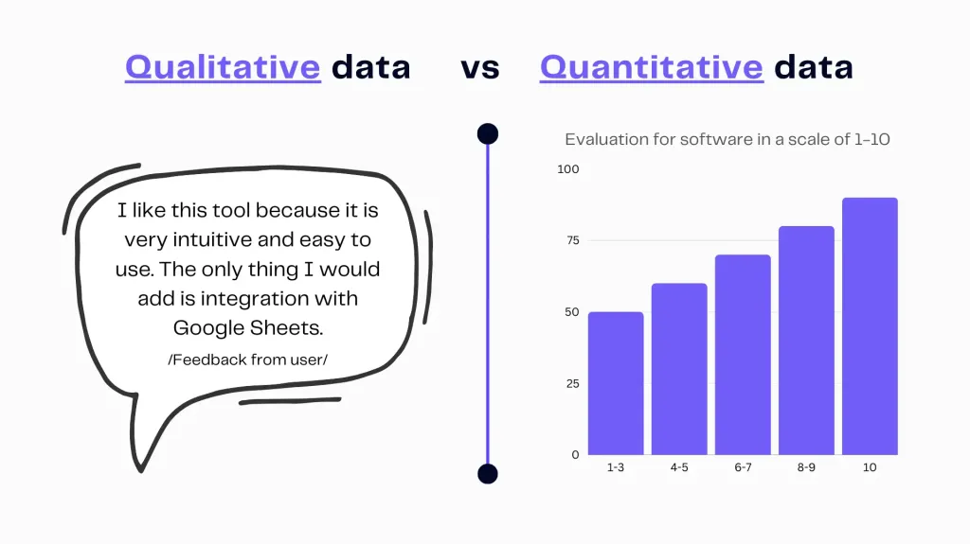
B. Quantitative versus Qualitative Data Collection Methods
Credit: https://ajelix.com/data/qualitative-data-visualization/

Slide 5
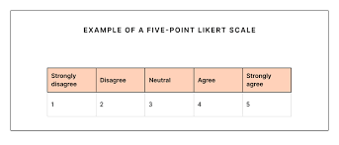
B. Quantitative versus Qualitative Data Collection Methods
It is really helpful to understand the basic differences between quantitative and qualitative methods.
Quantitative methods are effective for measuring patterns, frequencies, and the relationships between variables.
They usually have a clear, organised structure with closed-ended questions and response scales, such as Likert items.
The data gathered is numerical and analysed using statistical methods, making it easier to find meaningful insights.
Credit: https://www.cultureamp.com/blog/what-is-a-likert-scale

Slide 6
B. Quantitative versus Qualitative Data Collection Methods
Qualitative methods are well-suited for exploring lived experiences, perspectives, and meanings.
They are more flexible and employ open-ended questions that invite detailed and thoughtful responses.
The resulting rich data is typically in text form and is often analysed through thematic or narrative approaches, facilitating the uncovering of deeper insights.

Slide 7

B. Quantitative versus Qualitative Data Collection Methods
E.g., a quantitative question might be:
E.g., a qualitative question might be:
“On a scale of 1 to 5, how satisfied are you with this IT platform?”
“Can you describe a time you felt satisfied or dissatisfied with using this IT platform? Tell me why?”

Slide 8

C. General Considerations for the Design of Data Collection Methods
When you are working on either quantitative or qualitative research, some guiding principles can help with the design of data collection methods. These include:
I. Clarity: Questions should be easy to understand and free from jargon. Respondents should interpret questions in the same way.
II. Relevance: Each question should relate directly to the research objectives.
III. Sequencing: Questions should follow a logical order, usually starting from general to more specific.
IV. Ethical Sensitivity: Instruments must be designed in a way that respects respondents’ privacy and emotional comfort.
V. Cultural Appropriateness: Language and content should be suitable for the context and audience.
VI. Pilot Testing: Instruments should be pre-tested with a small sample to identify and correct any issues before full deployment.

Slide 9

D. Designing Quantitative Data Collection Methods
When designing quantitative data collection methods, the key aim is to generate measurable, structured data that can be systematically analysed.
This involves creating questionnaires or other tools that gather consistent and comparable information from all participants.

Slide 10
D. Designing Quantitative Data Collection Methods
I. Avoiding Complexity and Ambiguity
Quantitative questions must be clear and specific to avoid misinterpretation. Vague or confusing questions result in unreliable data.
So, instead of asking:
“How satisfied are you with the usability, latency, and data handling capabilities of your cloud-based development environment?”
This question is too complex as it combines multiple technical concepts and assumes the respondent understands terms like latency and data handling capabilities.

Slide 11
D. Designing Quantitative Data Collection Methods
I. Avoiding Complexity and Ambiguity
Improve it by breaking it down into separate, clear questions:
a. “How easy is it to use your cloud-based development environment?”
b. “How would you rate the speed (low delay or latency) of your cloud-based environment?”
c. “How satisfied are you with how your cloud-based platform manages data?”
This version avoids technical confusion and allows respondents to give focused answers that are easier to interpret and analyse.

Slide 12
D. Designing Quantitative Data Collection Methods
Avoiding Double-Barrelled Questions
Questions that ask about more than one issue at once make it difficult for respondents to answer clearly.
Example:
“Do you agree that online learning is cost-effective and efficient?”
This should be split into two separate items to get more accurate responses.
a. “Do you agree that online learning is cost-effective?”
b. “Do you agree that online learning is efficient?”

Slide 13
D. Designing Quantitative Data Collection Methods
III. Ensuring Exhaustiveness and Mutual Exclusivity
Closed-ended response options should cover all possible answers (exhaustiveness) and should not overlap (mutual exclusivity).
Example:
A. Please indicate your ICT experience:
a. Less than 1 year
b. 1–3 years
c. 3–5 years
d. More than 5 years
Ensure that no two categories overlap, and all possible responses are included.

Slide 14
D. Designing Quantitative Data Collection Methods
IV. Using Balanced and Consistent Scales
Likert-type items should consistently use the same scales throughout the instrument to prevent confusion. (A Likert scale is a widely used rating scale in surveys and questionnaires that measures people's attitudes, opinions, or perceptions towards a specific statement. It is named after Rensis Likert, the psychologist who developed it.)
Example of a good Likert scale question:
“Rate your agreement: ‘The learning management system is user-friendly.’”
a. Strongly Disagree
b. Disagree
c. Neutral
d. Agree
e. Strongly Agree
Maintain this same scale throughout the questionnaire to enhance reliability.

Slide 15

V. Preventing Respondent Fatigue A long, repetitive, or poorly organised questionnaire can lead to incomplete answers or disengagement. Only include questions directly linked to the research objectives.

Slide 16
V. Preventing Respondent Fatigue
Example:
Research objective: To investigate how often and how effectively ICT students use virtual lab environments in completing programming assignments.
Problematic questionnaire design that may lead to fatigue:
What is your age?
What is your marital status?
What is your parents' educational background?
What operating system do you use at home?
Do you use a smartphone?
Have you used the university's virtual lab environment before?
How often do you use the virtual lab?
What features of the virtual lab do you find most useful?

Slide 17
V. Preventing Respondent Fatigue
Example:
Research objective: To investigate how often and how effectively ICT students use virtual lab environments in completing programming assignments.
Enhanced, targeted version (reduces fatigue):
Have you used the university's virtual lab environment for programming tasks?
How often do you access the virtual lab in a typical week?
What challenges do you face when using the virtual lab?
Rate your satisfaction with the virtual lab's performance and usability.
Which features do you find most beneficial for completing programming assignments?

Slide 18
VI. Contribution to Data Analysis Plan
Every question should align with the research objectives and be carefully chosen to contribute directly to the final data analysis.
Example:
If your objective is to examine the frequency of ICT tool usage, include questions like:
“How many hours per week do you use cloud-based collaboration tools (e.g., Google Docs, Microsoft Teams)?”
0–2 hours
3–5 hours
6–10 hours
More than 10 hours

Slide 19
VII. Standardising Responses
Ensure common terms and scales are used to avoid confusion.
Example:
When asking about data consumption patterns, clearly define ranges:
“What is your monthly data usage?”
Less than 2GB
2–5GB
6–10GB
More than 10GB
This helps during statistical analysis, where standardised ranges support easy comparison.

Slide 20
E. Designing Qualitative Data Collection Methods
When planning to gather qualitative data, researchers must shift their focus from fixed-response questions to open-ended formats that foster rich, detailed explanations.
Unlike quantitative methods, which measure frequency or magnitude, qualitative methods aim to understand experiences, perceptions, and meanings.

Slide 21
E. Designing Qualitative Data Collection Methods
Crafting Open-Ended Questions
Good qualitative questions begin with words like how, what, or why, and avoid yes/no answers. They are designed to explore rather than measure.
Example:
Instead of asking:
“Do you like using Microsoft Teams for group work?”
(which would be closed), ask:
“How do you experience using Microsoft Teams for collaborating on group assignments?”
This allows the respondent to elaborate on their thoughts, challenges, benefits, and feelings.

Slide 22
E. Designing Qualitative Data Collection Methods
II. Using Probes and Follow-Up Questions
One of the strengths of qualitative data collection, particularly in interviews and focus groups, is the ability to probe more deeply. This involves asking follow-up questions based on the participant’s initial response to gain a more comprehensive understanding.
Example:
If a participant says:
“I find online programming tutorials helpful.”
The researcher might follow up with:
“Can you tell me more about what makes them helpful for you?”
This builds depth and clarity into the response.

Slide 23
E. Designing Qualitative Data Collection Methods
III. Maintaining a Neutral and Respectful Tone
It is essential that questions are non-leading, implying a specific answer. Participants should feel safe, respected, and free from judgment when expressing their views.
Leading question (to avoid):
“Don’t you think learning through simulations is more effective than traditional methods?”
Better version:
“What are your thoughts on using simulations compared to traditional classroom learning in IT training?”
This approach invites multiple viewpoints rather than guiding the respondent toward a specific answer.

Slide 24
E. Designing Qualitative Data Collection Methods
IV. Using an Interview or Discussion Guide
A qualitative data collection method typically appears as an interview schedule or focus group guide, which comprises:
• A short list of key themes or questions
• Space for probes
• Reminders about tone, ethical considerations, and consent
An interview guide for a study exploring mobile learning might include:
• “Tell me about your experience using educational mobile apps.”
• “What challenges have you faced when trying to learn with your phone?”
• “In what ways do mobile apps support your IT coursework?”

Slide 25
E. Designing Qualitative Data Collection Methods
V. Ethical Sensitivity and Contextual Awareness
Participants should feel at ease discussing even sensitive topics, such as inequalities in access to technology or digital stress. Ensuring confidentiality and fostering a welcoming environment promote honest and valuable responses.
A participant in a rural area may be hesitant to discuss poor internet access. A good researcher might reassure them:
“There are no right or wrong answers. Your experience is important, and it helps us understand different realities.”

Slide 26
E. Designing Qualitative Data Collection Methods
V. Ethical Sensitivity and Contextual Awareness
Designing qualitative data collection tools is more of an art than a strict formula.
It involves creating space for individuals to share their stories and perspectives.
In the ICT field, qualitative methods can reveal how students interact with technology, perceive learning platforms, and navigate digital environments; insights that numbers alone cannot capture.
By carefully designing open, flexible, and empathetic questions, researchers can gather rich data that thoroughly illuminates their research topic.

Slide 27
F. Aligning Data Collection Methods with Research Design
Ultimately, the choice and design of the data collection methods must align with the broader research paradigm.
Quantitative studies, which often seek generalisability, rely on structured data collection instruments suitable for large samples.
Qualitative studies, which seek depth and meaning, use flexible data collection instruments designed for rich data collection.

Slide 28
G. In conclusion
This introductory session lays the foundation for understanding how the quality of a research instrument directly influences the quality of the data collected.
A thoughtful, well-constructed instrument is key to credible and meaningful research outcomes.
You are encouraged to review Chapters 9 and 10 of the course text by Kumar, which cover data collection in detail.

Slide 29


Lower-Order MCQs
I. What is the primary purpose of pilot testing a data collection instrument?
A. To collect more responses from participants B. To finalise the research objectives C. To increase the sample size D. To identify and correct problems before full use

Slide 30
Lower-Order MCQs
II. Which of the following best defines 'clarity' in instrument design?
A. Making questions easy to understand and free from jargon B. Using technical terms to enhance accuracy C. Ensuring questions are long and detailed D. Asking multiple questions at once

Slide 31
Lower-Order MCQs
III. In survey design, what does ‘sequencing’ refer to?
A. Numbering each questionnaire page B. Arranging questions in a logical order C. Placing all demographic questions at the end D. Using different colours for sections

Slide 32
Lower-Order MCQs
IV. Which of the following is an example of a qualitative data collection method?
A. Online survey with numerical responses B. Structured multiple-choice questionnaire C. Tally sheet for frequency counts D. Semi-structured interview

Slide 33
Lower-Order MCQs
V. What does 'ethical sensitivity' in instrument design primarily ensure?
A. That questions are long and comprehensive B. That the researcher saves time during analysis C. That respondents’ privacy and comfort are respected D. That more data is collected

Slide 34
THAT’S IT!!!
See you next week for
SAMPLING IN RESEARCH!

